Slide 1
The small-world model

Slide 2
Regular graphs vs. random graphs
Random graphs have low transitivity (clustering coefficient).
Random graphs have small diameter.
On the other hand, regular graphs have large diameter and some of them have large transitivity.

Slide 3
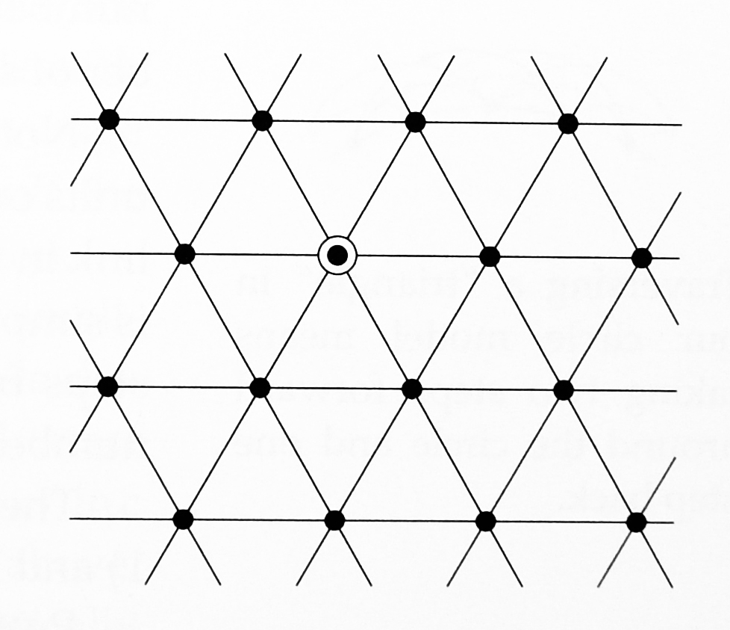
A triangular lattice
There are twice as many triangles in such a lattice as there are vertices.
There are connected triples for each vertex.
Clustering coefficient is

Slide 4
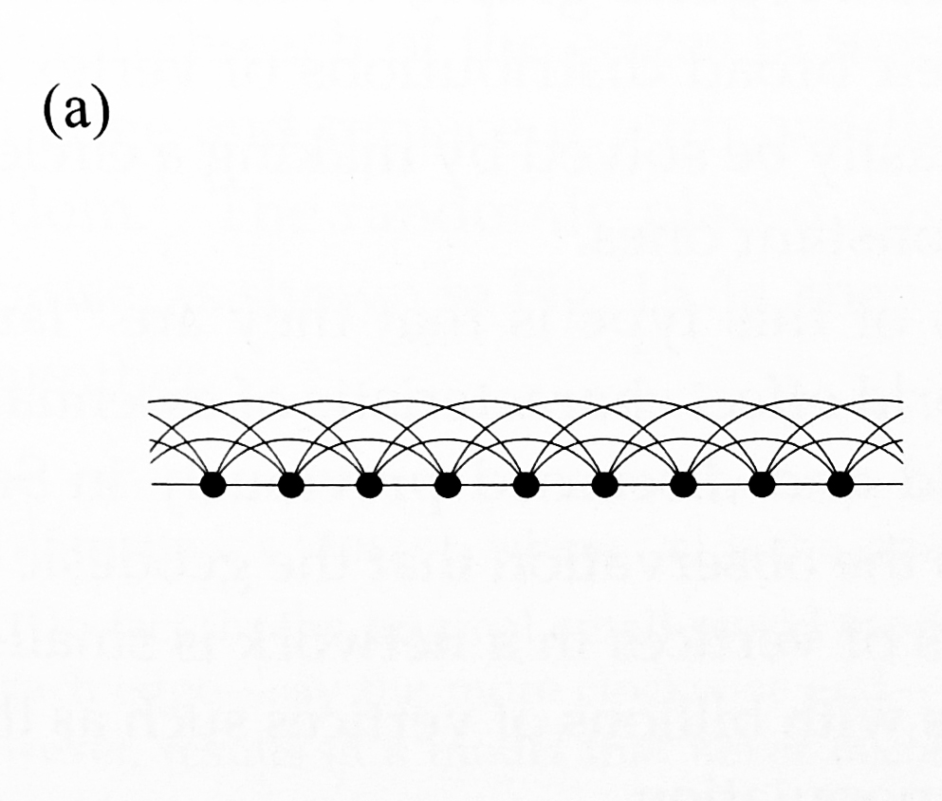
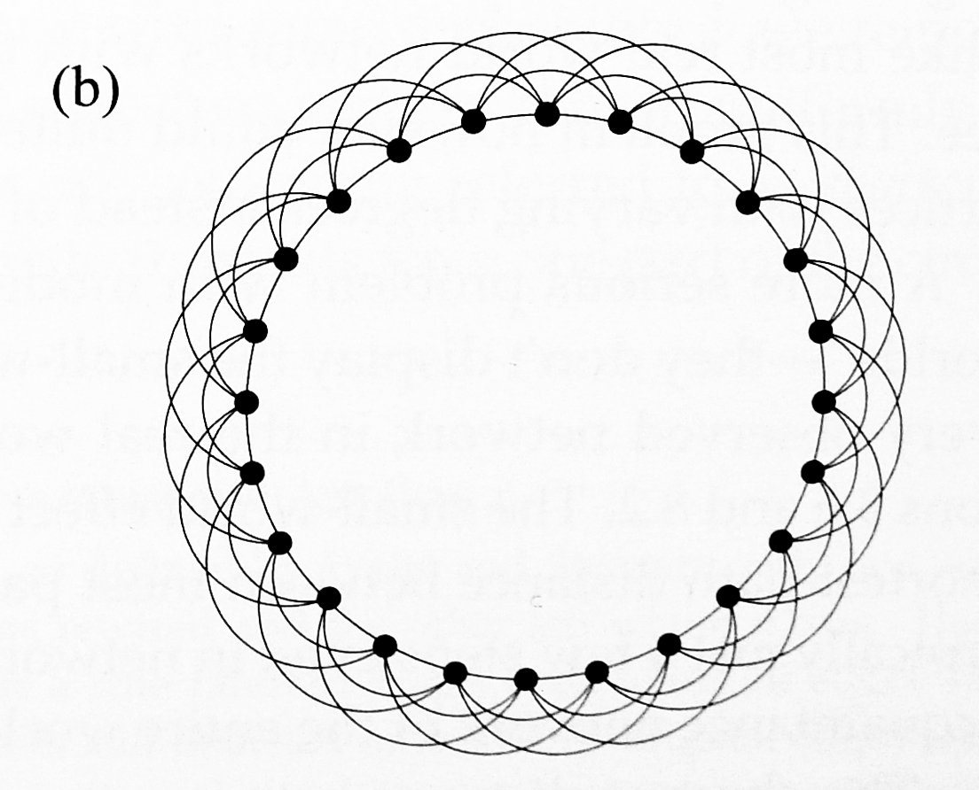
A simple one-dimensional network model (ring)
Every vertex is connected to c nearest neighbors in a line (a) or in a ring (b). Here c=6.

Slide 5
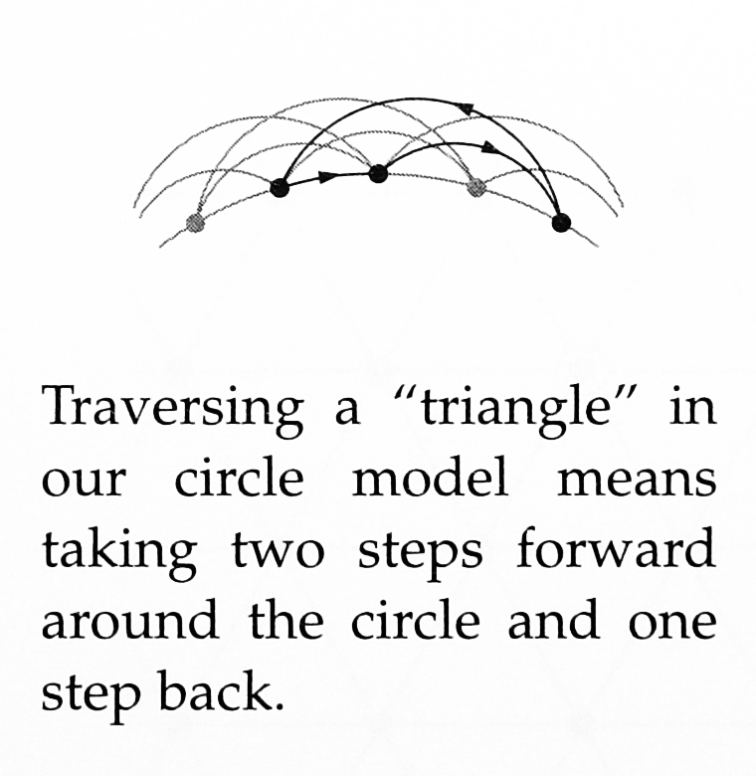
Clustering coefficient
Count the number of triangles
Two steps forward and one step back
The length of the last step can be chosen between 1,2,…c/2.
The number of ways to choose the first two steps is the number of positive integer solutions to , which is

Slide 6
Clustering coefficient
The total number of triangles is
Each vertex has degree c and the number of connected triples centered at a vertex is
This clustering coefficient varies from 0 for c=2 up to a maximum of ¾ when c

Slide 7
The mean shortest path
The farthest one can move around the ring in a single step is c/2.
So two vertices m lattice spacing apart are connected by a shortest path of 2m/c steps.
Averaging over the complete range of m from 0 to n/2 gives a mean shortest path of n/2c.
By contrast, the mean shortest path in the ER random graph is

Slide 8
The small-world model
Watts and Strogatz 1998
Interpolate between the ring model and the random graph by moving or rewiring edges from the ring to random positions.
Start with a ring model with n vertices in which every vertex has degree c.
Go through each edge in turn and with probability p we remove that edge and replace it with one (shortcut) that joins two vertices chosen uniformly at random.

Slide 9
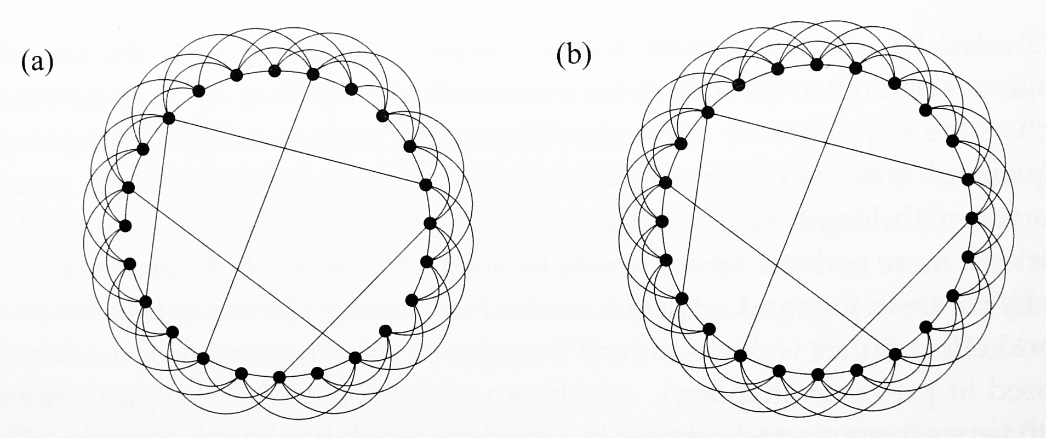
The small-world model
The original model: p=0 for the ring model and p=1 for the ER random graph.
Only the shortcuts are added. Do not remove the original edges.

Slide 10
The small-world model
The crucial point about the Watts-Strogatz small-world model is that as p is increased from 0 the clustering coefficient is maintained up to quite large values of p while the small-world behavior, meaning short average path lengths, already appears for quite modest values of p.
As a result, there is a substantial range of intermediate values for which the model shows both effects simultaneously, i.e., large clustering coefficient and short average path length.

Slide 11
Degree distribution of the variant of the small-world model
As each vertex has degree c, there are nc/2 edges in the ring model.
For each edge, we add a short cut with probability p, i.e., there are ncp/2 shortcuts on average.
This means cp average shortcuts end at a particular vertex.
Poisson distribution
Degree distribution (k=s+c)

Slide 12
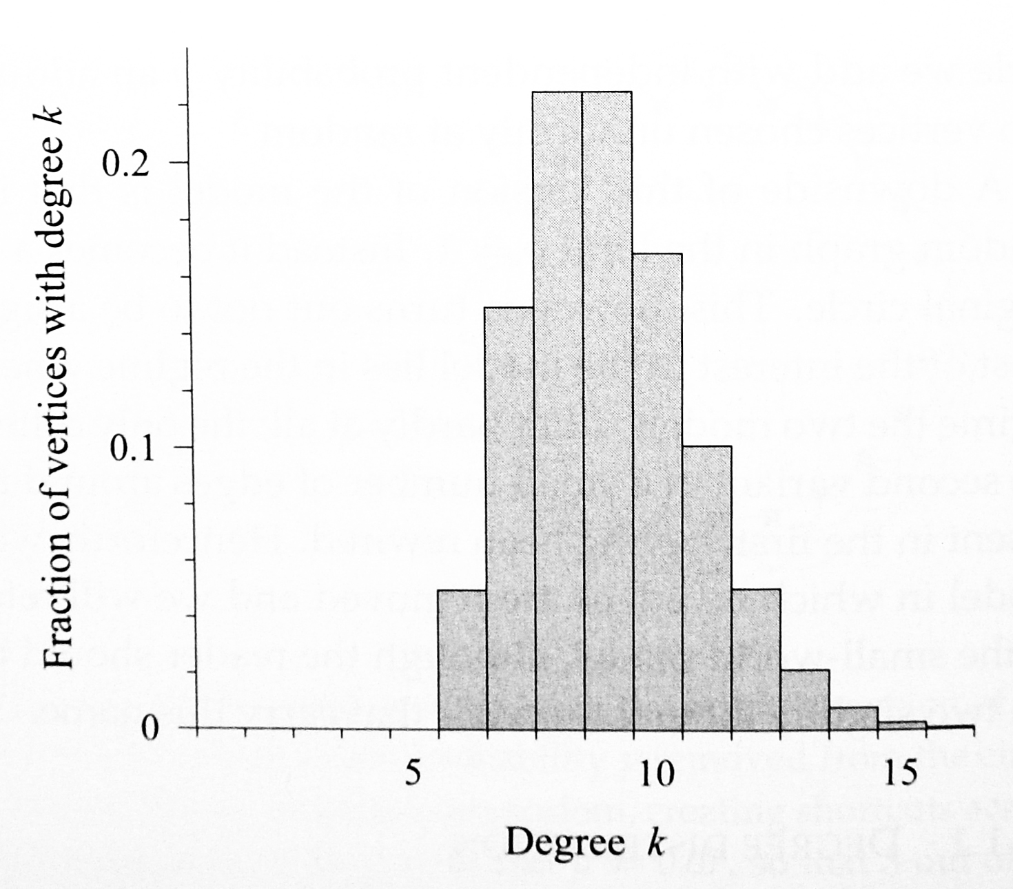
The degree distribution of the small-world model

Slide 13
Clustering coefficient
The number of triangle in the original ring model is
New triangles are introduced by shortcuts.
Vertex pairs c/2+1 to c steps apart are connected by one or more paths of length two and if the same vertices are connected by a shortcut those paths are turned into triangles.
The number of such paths of length two is clearly proportional to n.

Slide 14
Clustering coefficient
As the probability of connecting two vertices by a shortcut is cp/(n-1) (as in the ER model).
The number of new triangles is thus proportional to nxcp/(n-1), which is a constant (for large n).
It is safe to ignore these new triangles in the calculation of the clustering coefficient.
The number of connected triples in the original ring model is nc(c-1)/2.

Slide 15
Clustering coefficient
The number of new triples created by a shortcut and an edge in the ring is
There are on average ncp/2 shortcuts.
Every end of a shortcut is connected to a vertex with degree c and there are two ends of a shortcut.

Slide 16
Clustering coefficient
There are also triples created by pairs of shortcuts.
Suppose that a vertex is connected to m shortcuts. Then there are m(m-1)/2 triples made of two shortcuts centered on that vertex.
Averaging over the Poisson distribution of m, with mean cp, the expected number of connected triples at a vertex is for a total of triples over all vertices.

Slide 17
Clustering coefficient
Thus, the total number of connected triples of all types is
p=0 reduces to the ring model.
P=1 yields the minimum value of

Slide 18
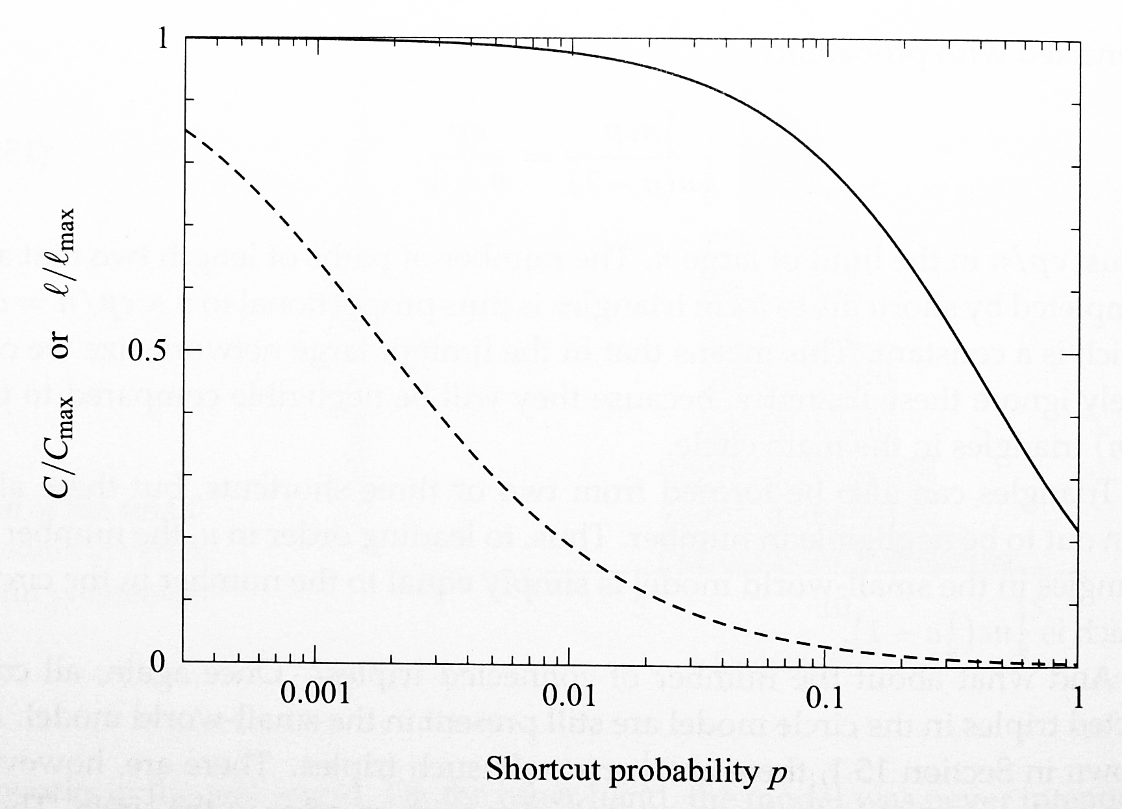
Clustering coefficient (solid line) and average path length (dashed line)

Slide 19
Average path length
Much more difficult.
Consider the simple case c=2 (the simple ring).
Suppose there are s shortcuts (and 2s ends of the shortcuts).
s is roughly ncp/2.
Then the average distance between ends is
Argue the average length must be in the form
For some function F.

Slide 20
Average path length
Increasing c from 2 to 4 will roughly halve the shortest path between any pair of vertices (in the original ring model).
This should be also true when the density of shortcuts is low.
Let f(x)=2F(x).

Slide 21
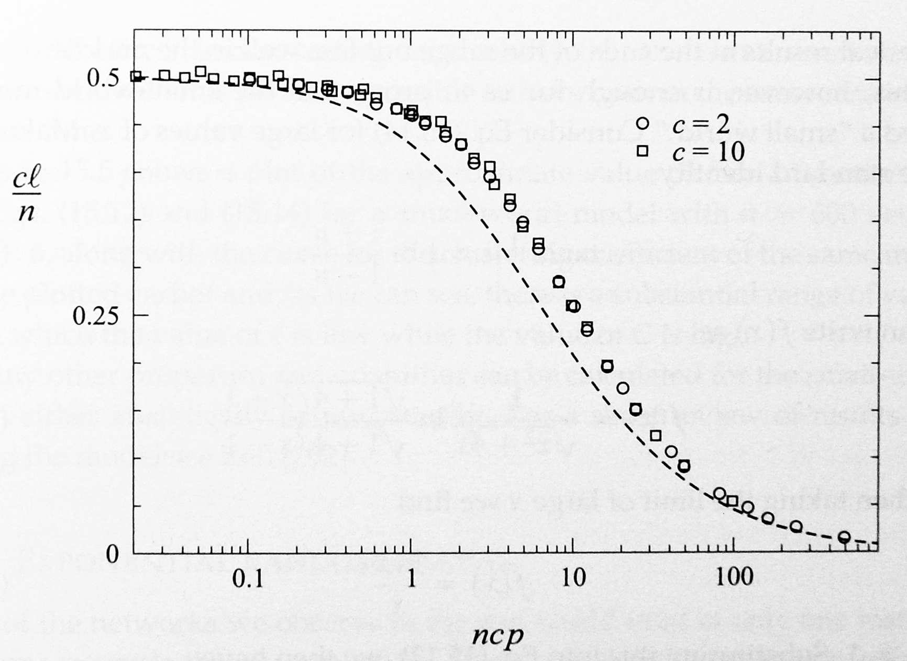
Scaling function for the small-world model

Slide 22
Average path length
A mean-field approximation by Newman et al. in 2000
For large x,
Only the number of shortcuts, i.e., ncp, (not the number per vertex) has to be large to produce the small-world behavior.

